Slide 1
Increasing Organizational Accountability and Performance: Activity Tracking for Employment Consultants
2015 APSE National Conference - Philadelphia
June 23-25, 2015
Alberto Migliore, PhD, University of Massachusetts Boston
Kelly Nye-Lengerman, MSW, University of Minnesota
Jeannine Pavlak, MS, New England Business Associates
Steve Aalto, MPA, CESP, Work Inc.
Notes:
Brief summary of where we are nationally
We have challenges at three levels:
Systems that establish a priority for employment
Organizations that get there
Supports that are innovative, flexible, and creative

Slide 2
Agenda
Introduction
Theory
Examples From Research
Examples From the Field
Q & A

Slide 3
Definitions
Employment consultants (ECs) are staff members in employment programs who assist job seekers with disabilities in finding employment. They also may be referred to as employment specialists, job developers, rehabilitation counselors, or employment support professionals.
Community rehabilitation programs (CRPs) are non-profit or for-profit, private or public organizations that provide a wide range of services—including employment services—to people with any types of disabilities.
Employment refers to work that pays at least minimum or prevailing wage and that entails working in an environment where the majority of co-workers do not have disabilities

Slide 4
What’s the problem?
American Community Survey
Notes:
Definition of Cognitive disability in ACS = Because of a physical, mental, or emotional condition lasting 6 months or more, the person has difficulty learning, remembering or concentrating

Slide 5
American Community Survey

Slide 6
What are the desired goals?
Higher employment rates
Higher wages and more work hours
Longer job retention
Career advancement

Slide 7
Any good news? Yes!
Employment first policies (12 states)
DoJ scrutiny on day programs
WIOA new provisions
Families’ higher expectations

Slide 8
Big picture
ECs
CRPs
Policies

Slide 9
Focus on Employment Consultants (EC)
“…Regardless of the job seeker’s level of motivation, skill, experience, attitude, and support system, his or her ability to get a job will often depend on the effectiveness of employment specialists…
Simply stated, if they (employment specialists) are good, job seekers get jobs. If they are not, the barriers to employment for job seekers can become insurmountable…”
(Lueking et al., 2004, p. 29)

Slide 10
What do we know about ECs?
Estimated 35,000 employment consultants serving the IDD population, nationally
The majority of ECs support up to five job seekers with IDD per year in getting employment (60%)
73% of job seekers makes $8 per hour or less
62% of job seekers work 20 or less hours/week
Migliore et al, 2010
Notes:
Estimated 500,000 adults with IDD receiving services from community rehabilitation programs (CRPs)
Estimated 6,000 CRPs, nationally

Slide 11
Part II
Theory

Slide 12
How to improve outcomes?
All organizational results are the product of behavior…
To improve results, you must first get people to change what they do…
Do it either more often, or less often, or do it entirely different…
Aubrey & Bailey, 2014

Slide 13
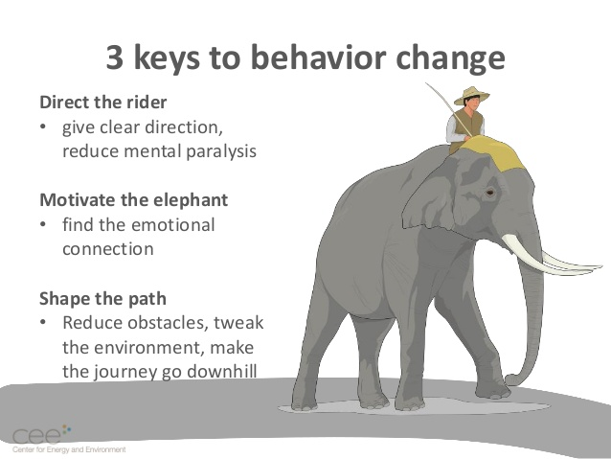
Heath & Heath, 2010
http://www.slideshare.net/mnceeInEx/using-behavior-change-principles-to-increase-the-performance-of-traditional-residential-energy-efficiency-programs
Notes:
Switch: How to Change Things When Change Is Hard 2010 by Chip Heath, Dan Heath

Slide 14
Direct the rider: Clarify goals
Identify what needs to be done
precisely define your expectations
Pinpoint the results you want
Daniels & Bailey, 2014; Drucker 2004

Slide 15
Examples of What Needs to be Done
Getting to know job seekers
Searching for jobs
Engaging employers to hire
Support after hire

Slide 16
Direct the rider: Measure progress
If you don’t measure it, you can’t tell if things are getting better, getting worse, or staying the same
Measurement allows you to see smaller changes in performance than you could NOT see through casual observation
People need useful information on how they are doing (i.e. feedback).
Daniels & Bailey, 2014

Slide 17
Direct the rider: Measure progress
Time is the scarcest and most precious resource we have...
A first step toward effectiveness is to record actual time use…
Without an action plan one becomes prisoner of events, without a way of assessing which events really matter
(Peter Drucker, 2004, p. 35)

Slide 18
Direct the rider: Measure progress
“…somehow you want to send the message clearly without getting people down. You can do that with numbers. People hear the message backed by numbers loud and clear. They say, ‘Boy, we’ve got to do something about that’…”
(Stack & Burlingham, 2013, p. 106)
Notes:
The Great Game of Business, Expanded and Updated: The Only Sensible Way to Run a Company, 2013 by Jack Stack (Author), Bo Burlingham

Slide 19
Motivate the elephant
Highlight successes
Share success stories, tips, and peer-to-peer encouragement
People do better when they are happy, have positive views of their organization
Believe that our work is contributing to something that matters…
(Amabile & Kramer, 2011; Heath & Heath, 2010; Stack & Burlingham, 2013).

Slide 20
Shape the path
Provide tools:
knowledge
Technology
Leadership
Supports

Slide 21
Part III
Examples from Research

Slide 22
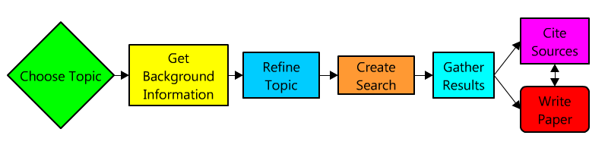
Research
Employment consultants (EC) survey (2009)
Pilot activity log (2013)
Community Rehabilitation Programs survey (2014)
Employment consultants Interviews (2015)
Daily survey (2016)

Slide 23
What Domains have we Measured?
Getting to know job seekers
Searching for jobs
Engaging employers to hire
Support after hire

Slide 24
What Tools Have We Used?
Survey: Multiple choice/Likert scale
Activity log on paper
Daily survey for smart phones (in progress)

Slide 25
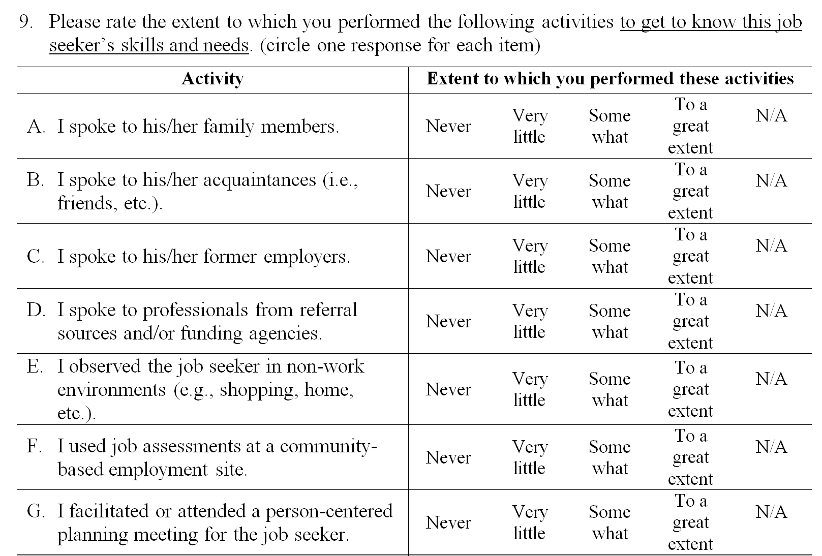
Example of Survey

Slide 26
Example of Survey findings
Percentage of ECs performing these activities for most or all job seekers… to get to know job seekers
N= 163 Ecs in 28 states
Notes:
Note that questions can be asked referring to either a specific job seeker (see previous slide) or all job seekers (this slide)

Slide 27
…to search for jobs?
*In the past three months

Slide 28
Survey Pros and Cons
Pros
Relatively quick/easy
One-time measure
Allows to track several activities
Cons
Self-reported
Accuracy is an issue
No quantitative measurements

Slide 29
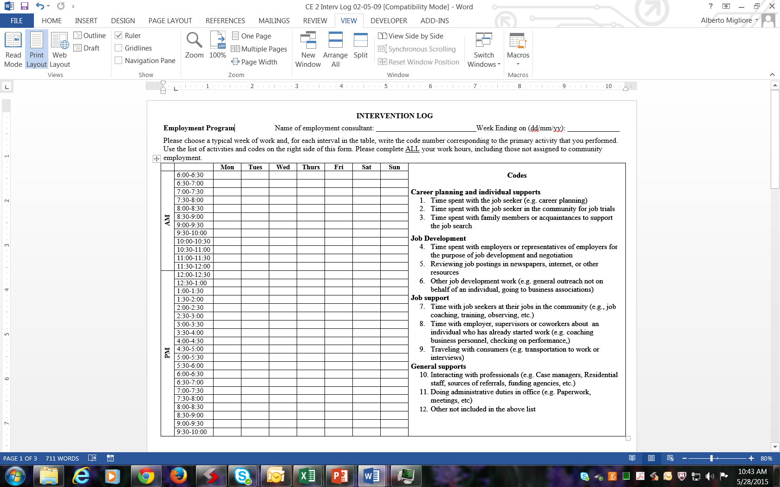
Example of Activity Log

Slide 30
Example of Activity log Findings

Slide 31
Activity Log Pros and Cons
Pros
More Precise (Tracks 30 minutes periods)
More Objective
Cons
Limited number of activities tracked
Time consuming/distracting
People may forget

Slide 32
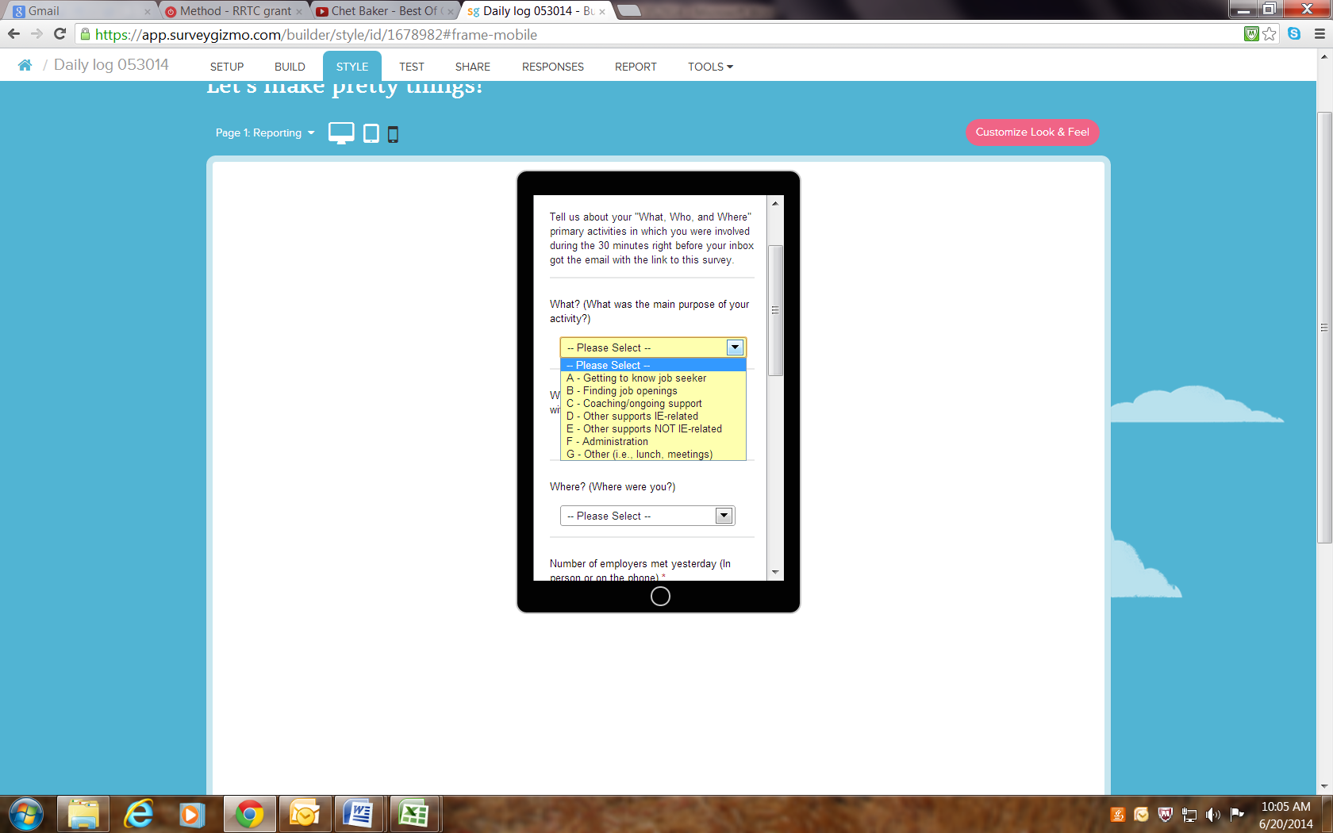
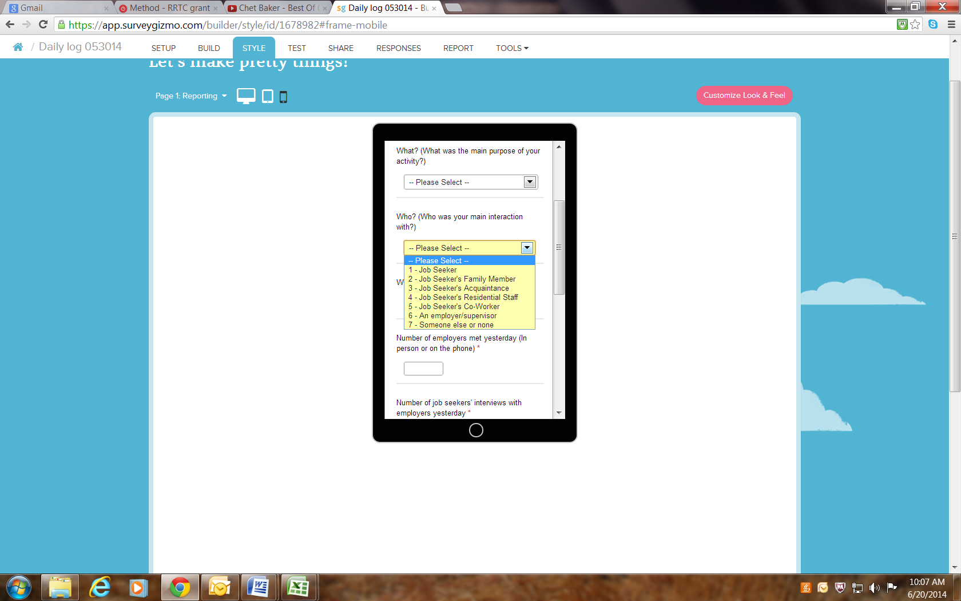
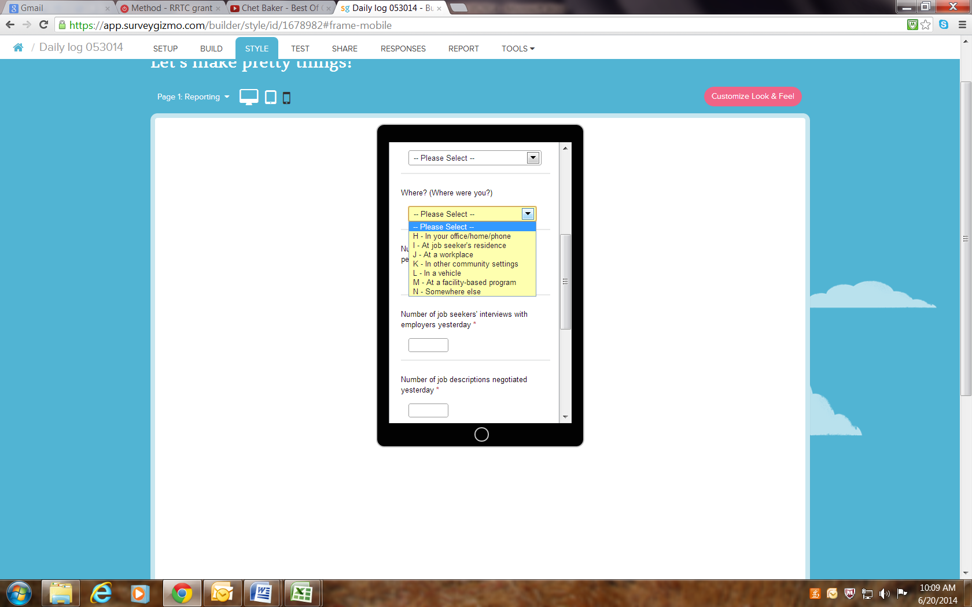
What’s next? Daily Survey for Smart Phones
Notes:
Data are collected daily, at a random time of the day every day.

Slide 33

Pros and Cons
Pros
More activities tracked: What, Who, and Where and their combination
Precise (30 minutes periods)
Immediate
Less disruptive
Longer data collection (1 year)

Slide 34
Cons
Not everybody have smart phones
Requires connectivity to a cellular network
Samples only 30 minutes per day

Slide 35
What Data Tracking Tools do CRPs use?

Slide 36
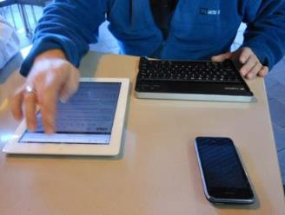
What Web-based tools are available?
set-works.com
salesforce.com
therapservices.net
State-provided tools
Agency developed tools

Slide 37
Part IV
Examples from the Field:

Slide 38
NEBA
Please request the slides to Jeannine Pavlak at jeannine.pavlak@nebaworks.com

Slide 39
Work Inc.
Please request the slides to Steve Aalto at Saalto@workinc.org

Slide 40
Conclusions
Use data to drive performance
Explore what others do
Start low tech
Invest in technology
Try, assess, revise, repeat

Slide 41
Questions?

Slide 42
References
Amabile, T., & Kramer, S. (2011) The progress principle: using small wins to ignite joy, engagement, and creativity at work. Cambridge, MA: Harvard Business School Publishing.
Butterworth, J., Migliore, A., Nord, D., Gelb, A. (2012). Improving the employment outcomes of job seekers with intellectual and developmental disabilities: A training and mentoring intervention for employment consultants. Journal of Rehabilitation, 78(2), 20-29.
Butterworth, J., Winsor, J., Smith, F. A., Migliore, A., Domin, D, Ciulla Timmons, J. & Hall, A.C. (2015). StateData: The national report on employment services and outcomes. Boston, MA: University of Massachusetts Boston, Institute for Community Inclusion.
Daniels AC & Bailey JS (2014) Performance Management: Changing behavior that drives organizational effectiveness (5th edition) Atlanta GA: Performance Management Publications
Drucker, P., F. (2004) The Effective Executive: The Definitive Guide to Getting the Right Things Done. New York, NY: HarperCollins Publisher Inc.
Few, F. (2006) Information Dashboard Design: The Effective Visual Communication of Data. Sebastopol, CA. O’Reilly Media Inc.
Heath, C. and Heath, D. (2010) Switch: How to Change Things When Change Is Hard. New York, NY: Broadway Books.
Luecking, R. G., Fabian, E. S., & Tilson, G. P. (2004). Working relationships: Creating careers for job seekers with disabilities through employer partnerships. Baltimore, MD: Paul H. Brookes Publishing Co.
Migliore, A., Hall, A., Butterworth, J., Winsor, J. (2010) What do employment specialists really do? A study on job development practices. Research and Practice for Persons with Severe Disabilities, 35(1-2), 15-23.
Stack, J., & Burlingham, B. (2013) The Great Game of Business, Expanded and Updated: The Only Sensible Way to Run a Company. New York, NY. Crown Business.

Slide 43




Contact information
Alberto Migliore, PhD, University of Massachusetts, alberto.Migliore@umb.edu
Kelly Nye-Lengerman, MSW, University of Minnesota knye@umn.edu
Jeannine Pavlak, MS, New England Business Associates jeannine.pavlak@nebaworks.com
Steve Aalto, MPA, CESP, Work Inc. Saalto@workinc.org

Slide 44
Acknowledgements
Funding for this presentation were through The Rehabilitation Research and Training Center on Advancing Employment for Individuals with Intellectual and Developmental Disabilities, Grant # H133B140026, National Institute on Disability, Independent Living, and Rehabilitation Research, Administration for Community Living, U.S. Department of Health and Human Services.
We would like to thank John Butterworth (University of Massachusetts Boston) and Derek Nord (University of Minnesota) for their work as team members of the research activities described in this presentation.

